Slide 1
Understanding and Deriving Simple Linear Regression
Phuc Loi Luu, PhD
luu.p.loi@googlemail.com
p.luu@garvan.org.au

Slide 2
Content
Derive Simple Linear Regression
Linear Algebra
Calculus
Statistics
Algorithms to find the solution for Simple Linear regression
Gradient descent
Pseudo Inverse
Multiple Linear Regression
Related linear regression

Slide 3
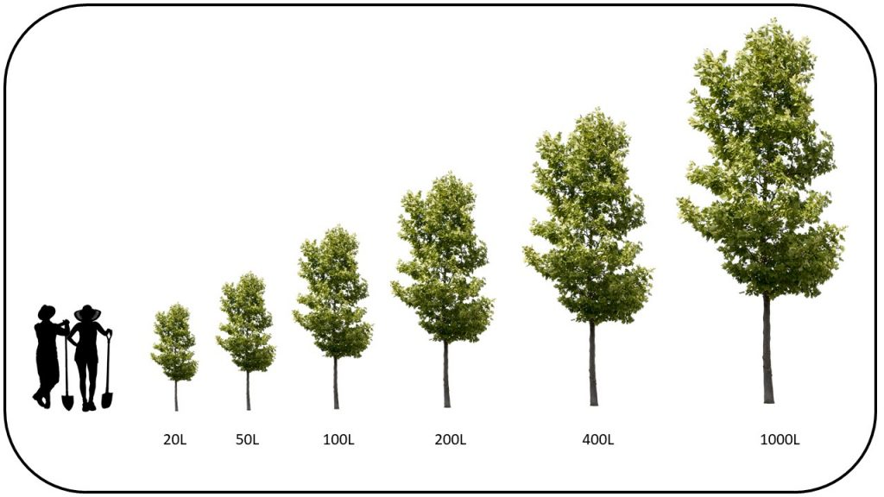
Prediction weight of tree using age: Simple Linear Regression

Slide 4
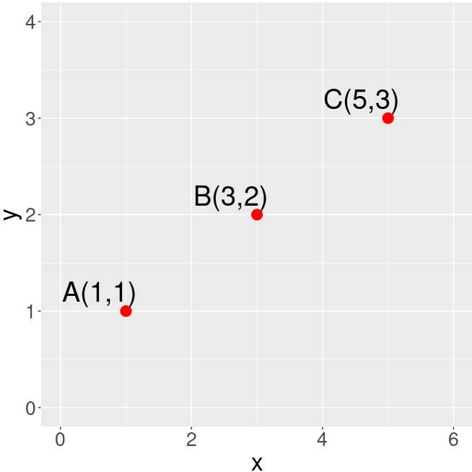
Fitting a line going through three points (1): Linear Algebra
A B C
 | x (Age) | y (Weight)
A | 1 | 1
B | 3 | 2
C | 5 | 3
How to find the line going through A and B?
y = f(x) = m*x + c
library(ggplot2)
## plot 3 points
p <- ggplot(data=data.frame(x=0, y=0), mapping = aes(x=x, y=y)) +
geom_text(x=1-0.4, y=1+0.2, label="A(1,1)", size=10) +
geom_text(x=3-0.4, y=2+0.2, label="B(3,2)", size=10) +
geom_text(x=5-0.4, y=3+0.2, label="C(5,3)", size=10) +
geom_point(x=1, y=1, color="red", size=5) +
geom_point(x=3, y=2, color="red", size=5) +
geom_point(x=5, y=3, color="red", size=5) +
xlim(0,6) + ylim(0, 4) +
theme(text = element_text(size = 25))

Slide 5
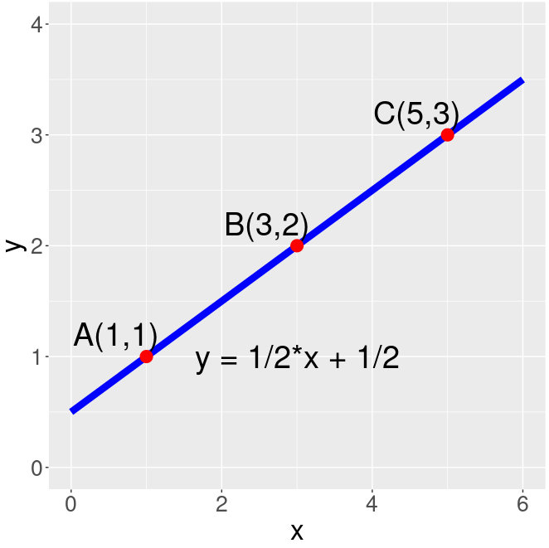
Fitting a line going through three points (2)
 | x (Age) | y (Weight)
A | 1 | 1
B | 3 | 2
C | 5 | 3
Find the line going through A and B: y = f(x) = m * x + c
For A: 1 = m * 1 + c (1)
For B: 2 = m * 3 + c (2)
For B: 3 = m * 5 + c (3)
Solving system of 2 equations (1) and (2):
m = 1/2
c = 1/2
replace values of m, c to (3): 3 = 1/2*5 + 1/2 (TRUE)
=> y = 1/2*x + 1/2 with m =1/2 and c=1/2
library(ggplot2)
## plot line going through 3 points
l2 <- function(x){ 1/2*x + 1/2 }
p <- ggplot(data = data.frame(x = 0), mapping = aes(x = x)) +
stat_function(fun = l2, color="blue", size=3) + xlim(0,6) + ylim(0, 4) +
geom_text(x=1-0.4, y=1+0.2, label="A(1,1)", size=10) +
geom_text(x=3-0.4, y=2+0.2, label="B(3,2)", size=10) +
geom_text(x=5-0.4, y=3+0.2, label="C(5,3)", size=10) +
geom_point(x=1, y=1, color="red", size=5) +
geom_point(x=3, y=2, color="red", size=5) +
geom_point(x=5, y=3, color="red", size=5) +
geom_text(x=3, y=1, label="y = 1/2*x + 1/2", size=10) +
theme(text = element_text(size = 25))

Slide 6
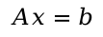
Fitting a line going through three points (3)
 | x (Age) | y (Weight)
A | 1 | 1
B | 3 | 2
C | 5 | 3
FInd the line going through A and B:
y = m * x + c
For A: 1 = m * 1 + c
For B: 2 = m * 3 + c
For C: 3 = m * 5 + c
Rewrite system of 3 equations into matrix format
$$Ax=b$$

Slide 7
Fitting a line going through three points (4)
 | x (Age) | y (Weight)
A | 1 | 1
B | 3 | 2
C | 5 | 3
FInd the line going through A and B:
y = m * x + c
For A: 1 = m * 1 + c
For B: 2 = m * 3 + c
For C: 3 = m * 5 + c
Rewrite system of 3 equations into matrix format
1 | 1
3 | 1
5 | 1
1
2
3
m
c
=
$$Ax=b$$

Slide 8
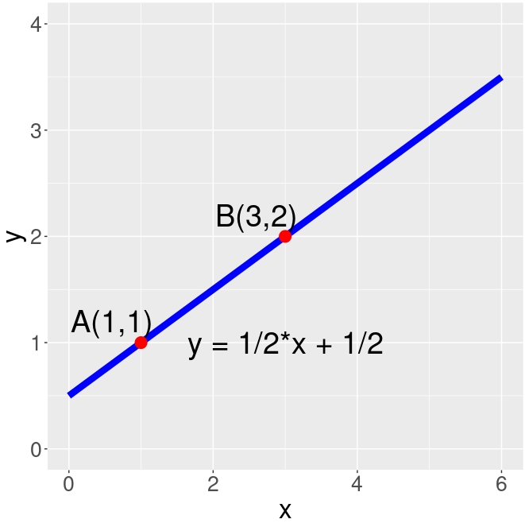
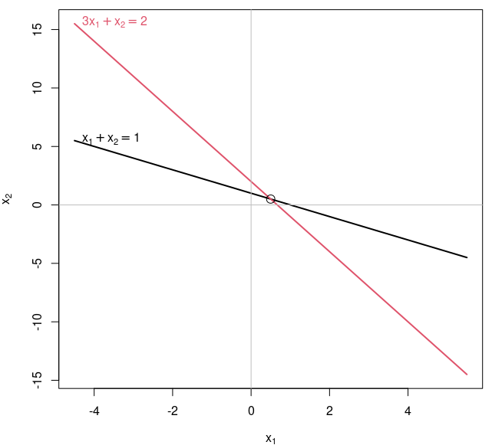
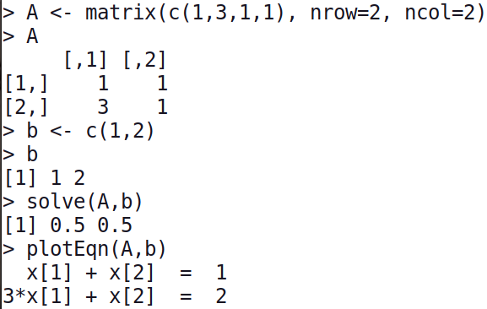
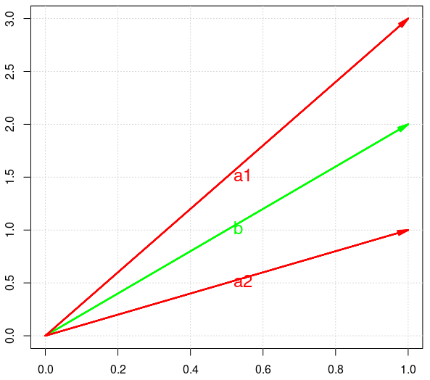
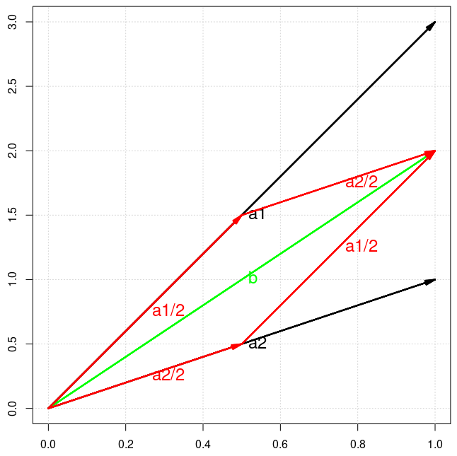
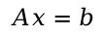
Fitting a line going through two points (5)
 | x (Age) | y (Weight)
A | 1 | 1
B | 3 | 2
1 | 1
3 | 1
m
c
1
2
=
m=0.5
c=0.5
$$Ax=b$$
a1 a2 b
1
3
1
1
1
2
m + c =
m=0.5
c=0.5

Slide 9
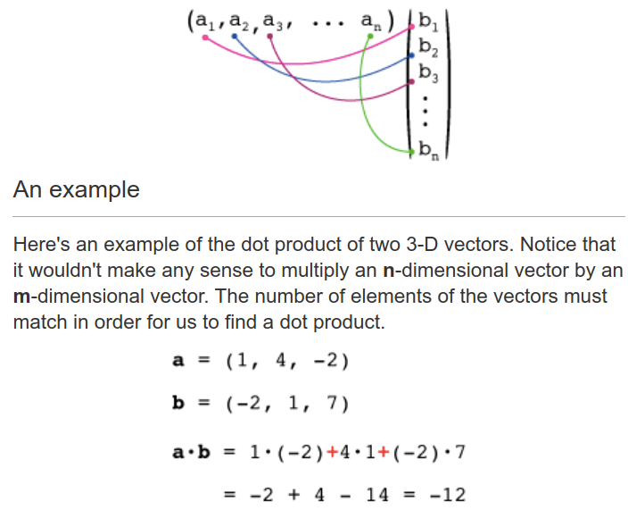
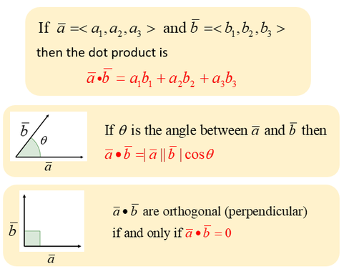
Multiplying vectors: The dot (scalar/inner) product
https://xaktly.com/MatrixOperations.html
https://en.wikipedia.org/wiki/Inner_product_space

Slide 10
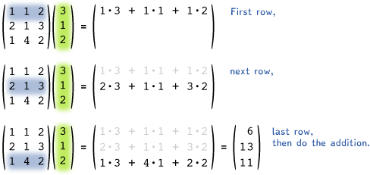
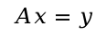
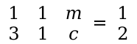
A 3×3 matrix multiplied by a 3×1 vector
$$\begin{matrix}1 & 1 \\ 3 & 1\end{matrix} \begin{matrix} m \\ c\end{matrix} = \begin{matrix}1 \\ 2\end{matrix}$$
$$Ax=y$$
https://xaktly.com/MatrixOperations.html

Slide 11
Fitting a line going through multiple points with one feature
Plant | x (Age, month) independent variable/predictor/ feature/attribute | y (Weight, gram) dependent/Predicted variable/class
A | 1 | 1
B | 3 | 2
C | 5 | 3
... | ... | ...
Matrix format:
1 | 1
3 | 1
5 | 1
... | ...
1
2
3
...
m
c
=
$$Ax=b$$

Slide 12
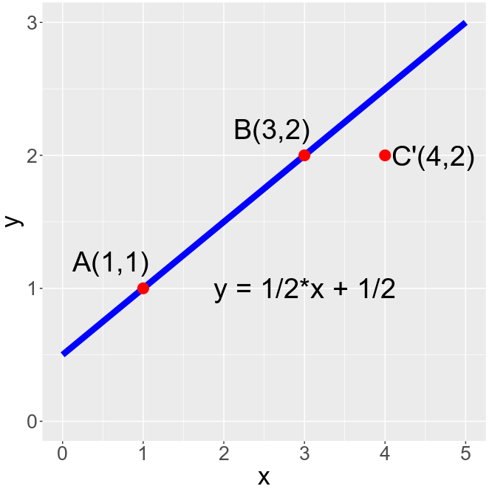
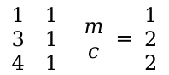
Cannot Fitting a line going through three points
 | x | y
A | 1 | 1
B | 3 | 2
C’ | 4 | 2
There is not a line going through A, B and C’:
y = m * x + c
For A: 1 = m * 1 + c
For B: 2 = m * 3 + c
For C’: 2 = m * 4 + c
=> Why ?
Rewrite system of 3 equations into matrix format:
$$\begin{matrix}1 & 1 \\ 3 & 1 \\ 4 & 1\end{matrix} \begin{matrix} m \\ c\end{matrix} = \begin{matrix}1 \\ 2 \\ 2\end{matrix}$$
$$Ax=b$$

Slide 13
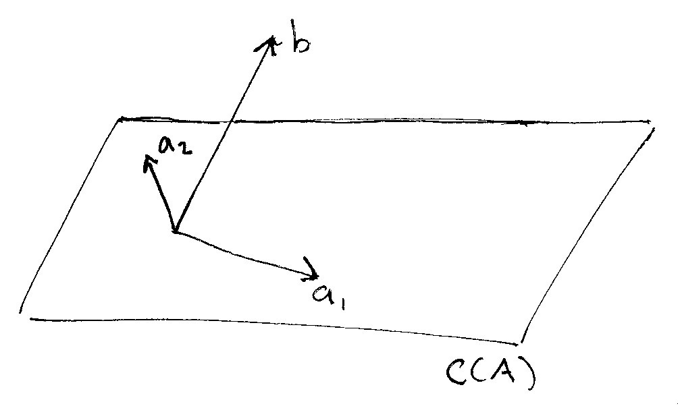
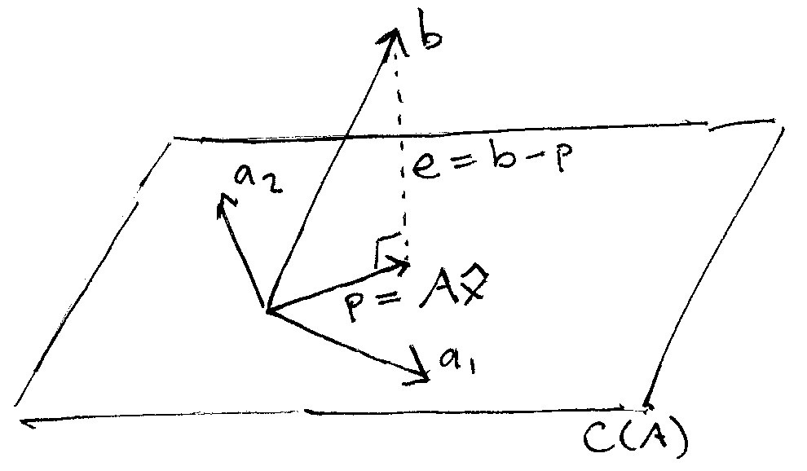
Cannot Fitting a line going through three points
$$\begin{matrix}1 & 1 \\ 3 & 1 \\ 4 & 1\end{matrix} \begin{matrix} m \\ c\end{matrix} = \begin{matrix}1 \\ 2 \\ 2\end{matrix}$$
1
3
4
1
1
1
1
2
2
m + c =
$$Ax=b$$
a1 a2 b

Slide 14
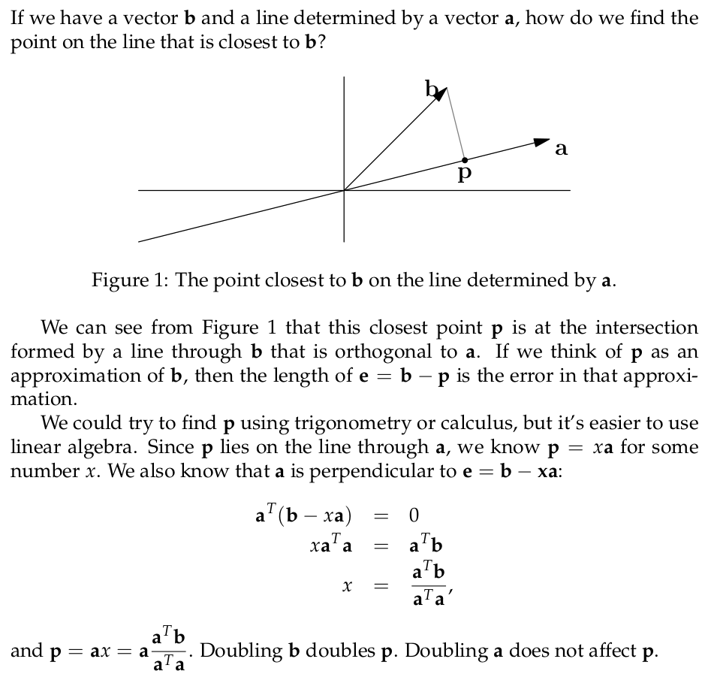
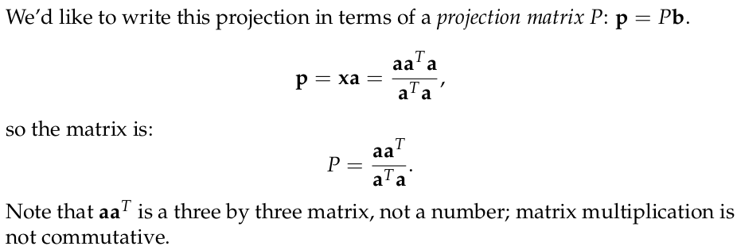
a^{T}.e = 0
a^{T}.(b-xa) = 0
1x3 3x1
3x1 1x3
1
3
4
1
1
1
1
2
2
m + c =
a1 a2 b

Slide 15
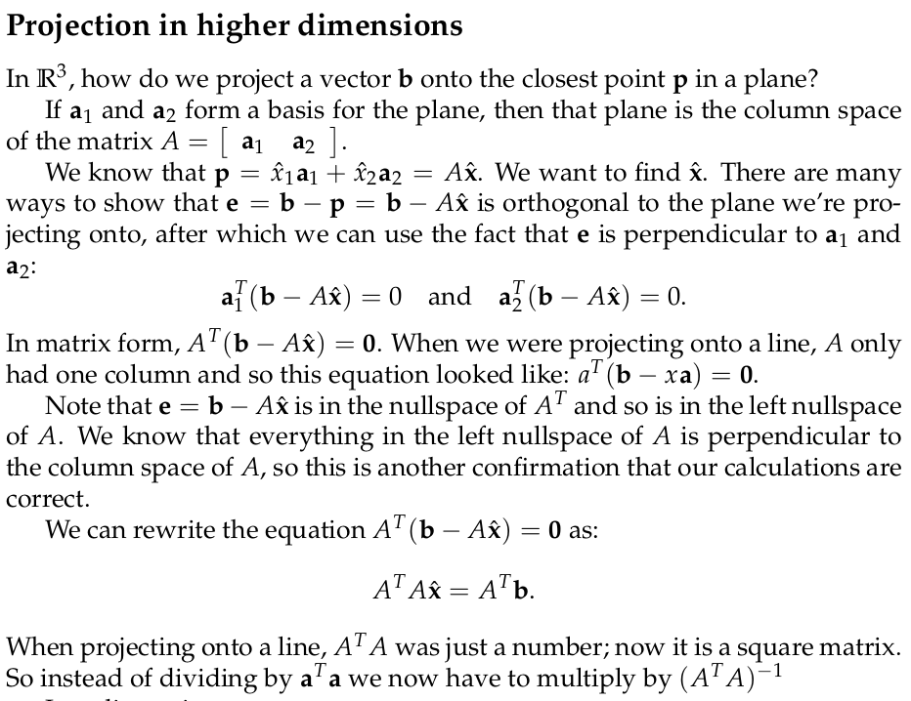
Ax=b
A^{T}Ax=A^{T}b

Slide 16
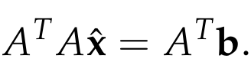
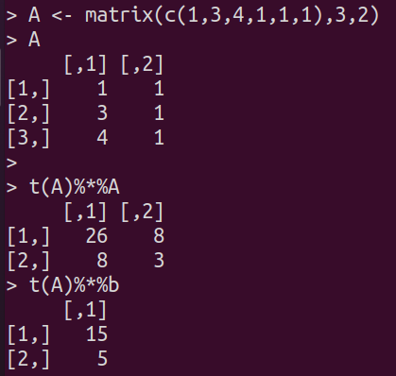
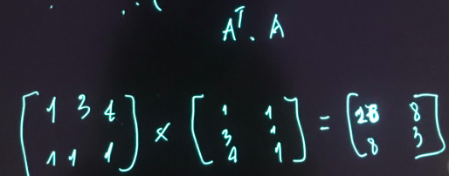
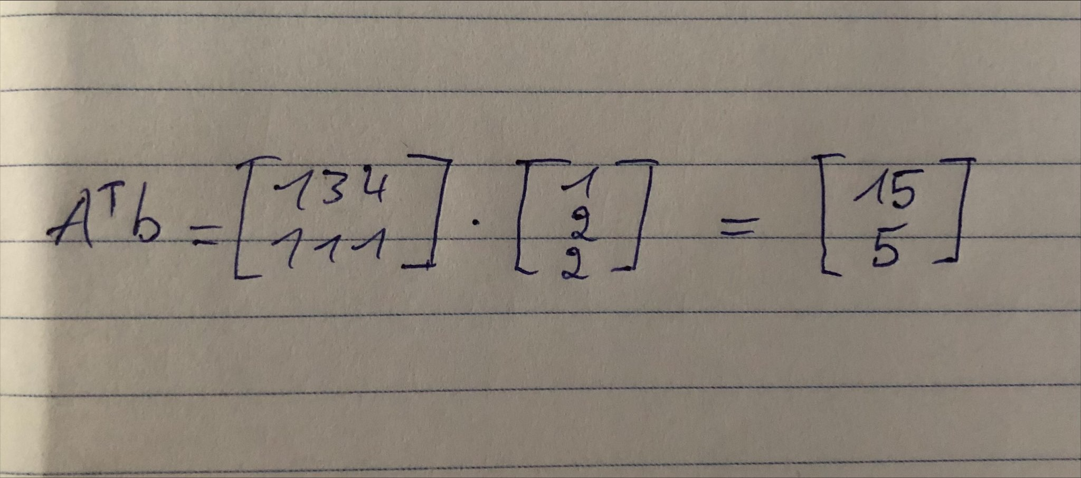
Exercise: Cannot Fitting a line going through three points
1
3
4
1
1
1
1
2
2
m + c =
$$\begin{matrix}1 & 1 \\ 3 & 1 \\ 4 & 1\end{matrix} \begin{matrix} m \\ c\end{matrix} = \begin{matrix}1 \\ 2 \\ 2\end{matrix}$$
a1 a2 b
$$Ax=b$$
Compute A^{T}A, A^{T}b to find x in the normal equaltion
> m
[1] 0.3571429
> c
[1] 0.7142857

Slide 17
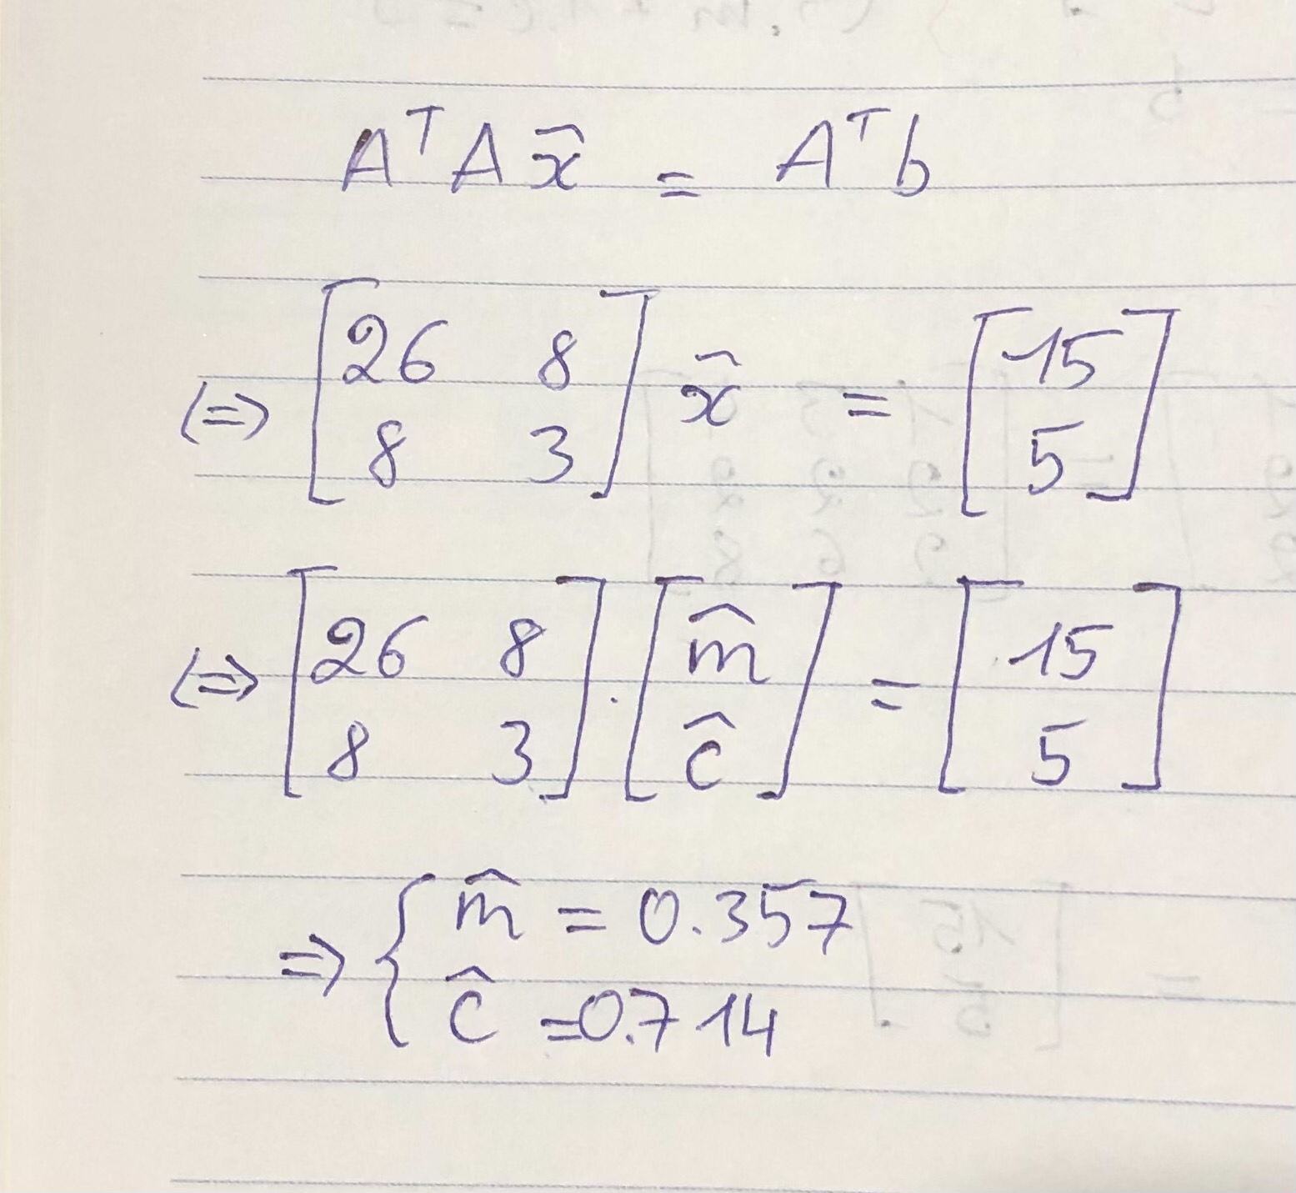
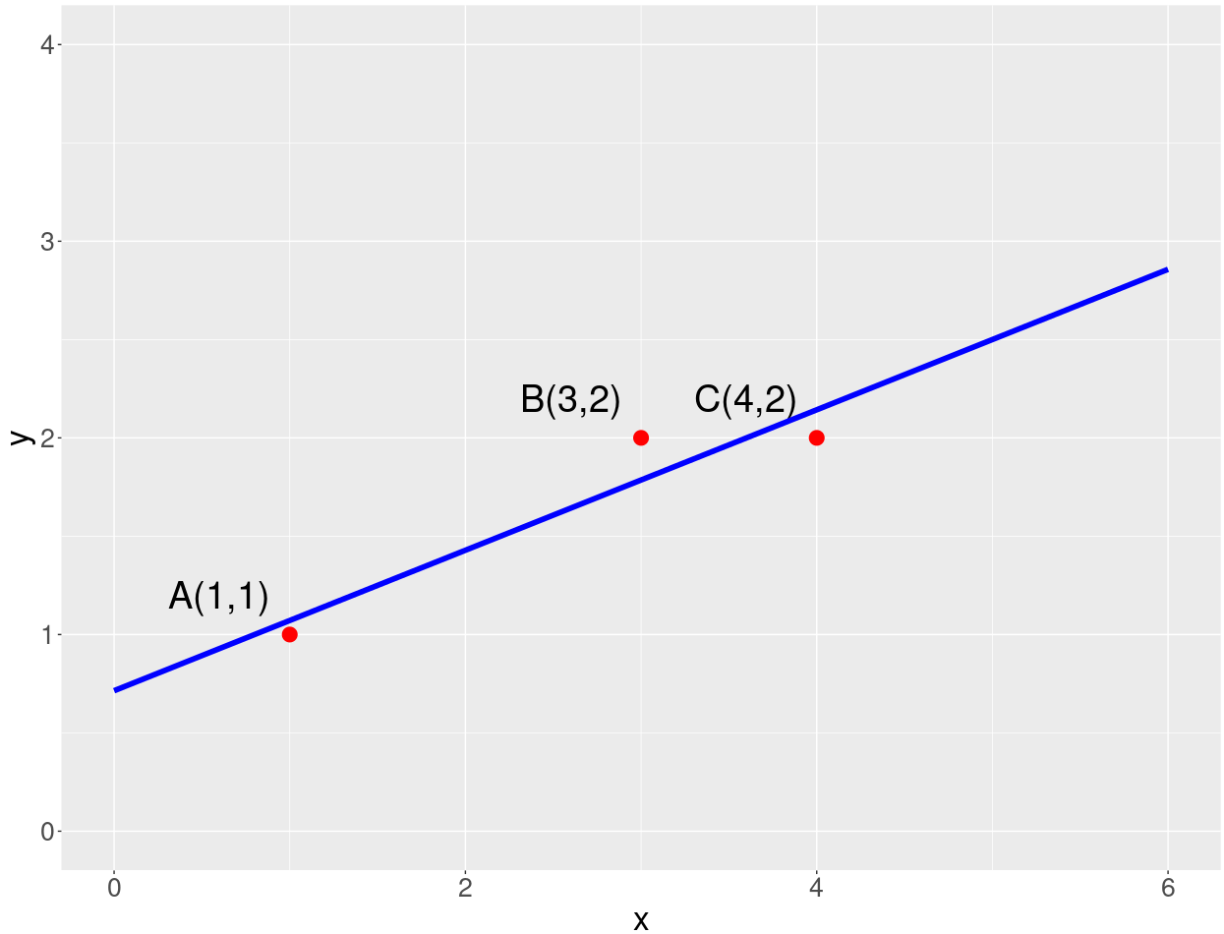
Exercise: Cannot Fitting a line going through three points
$$\begin{matrix}1 & 1 \\ 3 & 1 \\ 4 & 1\end{matrix} \begin{matrix} m \\ c\end{matrix} = \begin{matrix}1 \\ 2 \\ 2\end{matrix}$$
1
3
4
1
1
1
1
2
2
m + c =
$$Ax=b$$
a1 a2 b
Compute A^{T}A, A^{T}b to find x in the normal equation

Slide 18
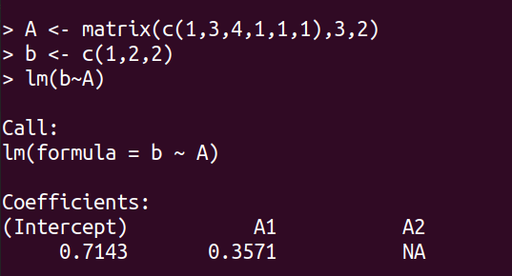
Exercise: using R to check the result
$$\begin{matrix}1 & 1 \\ 3 & 1 \\ 4 & 1\end{matrix} \begin{matrix} m \\ c\end{matrix} = \begin{matrix}1 \\ 2 \\ 2\end{matrix}$$
1
3
4
1
1
1
1
2
2
m + c =
$$Ax=b$$
a1 a2 b
A <-
b <-
lm(?~?)

Slide 19
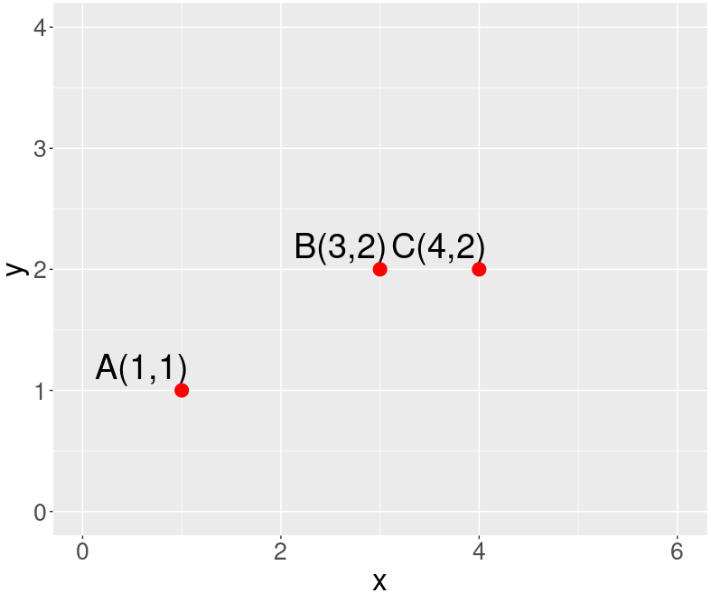
Cannot Fitting a line going through three points: using calculus
1
3
4
1
1
1
1
2
2
m + c =
$$\begin{matrix}1 & 1 \\ 3 & 1 \\ 4 & 1\end{matrix} \begin{matrix} m \\ c\end{matrix} = \begin{matrix}1 \\ 2 \\ 2\end{matrix}$$
a1 a2 b
$$Ax=b$$
There is not a line going through A, B and C’:
y = m * x + c
For A: 1 = m * 1 + c
For B: 2 = m * 3 + c
For C’: 2 = m * 4 + c
Minimize sum of square of e_{A}, e_{B}, e_{C}
e_{C}
e_{B}
e_{A}

Slide 20
Exercise: Minimize sum of square of e_{A}, e_{B}, e_{C}
There is not a line going through A, B and C’:
y = m * x + c
For A: 1 = m * 1 + c
For B: 2 = m * 3 + c
For C’: 2 = m * 4 + c
e²_{A} = (y_{Aline} - y_{A})² = (m * 1 + c - 1)² = (m + c - 1)²
e²_{B} = (y_{Bline} - y_{B})² = (m * 3 + c - 2)² = (3m + c - 2)²
e²_{C} = (y_{Cline} - y_{C})² = (m * 4 + c - 2)² = (4m + c - 2)²
e²_{total} = e²_{A} + e²_{B} + e²_{C} = (m + c - 1)² + (3m + c - 2)² + (4m + c - 2)² = c^2+m^2-2m+2cm-2c+1+c^2+9m^2-12m+6cm-4c+4+c^2+16m^2-16m+8cm-4c+4
= 26m²+3c²-30m+16cm-10c+9
de²_{total} /dm = 52m + 16c - 30 = 0
de²_{total} /dc = 16m + 6c - 10 = 0
-> m = 5/14 = 0.357 and c = 5/7 = 0.714
$$\begin{matrix}1 & 1 \\ 3 & 1 \\ 4 & 1\end{matrix} \begin{matrix} m \\ c\end{matrix} = \begin{matrix}1 \\ 2 \\ 2\end{matrix}$$
$$Ax=b$$
e_{C}
e_{B}
e_{A}

Slide 21
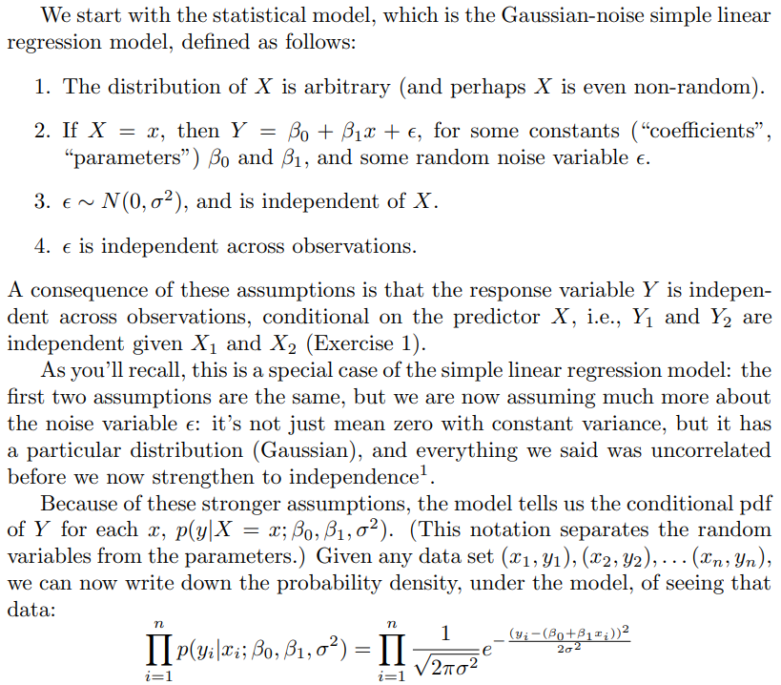
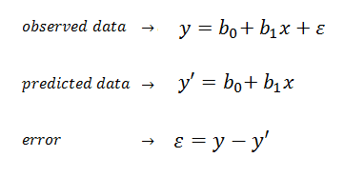
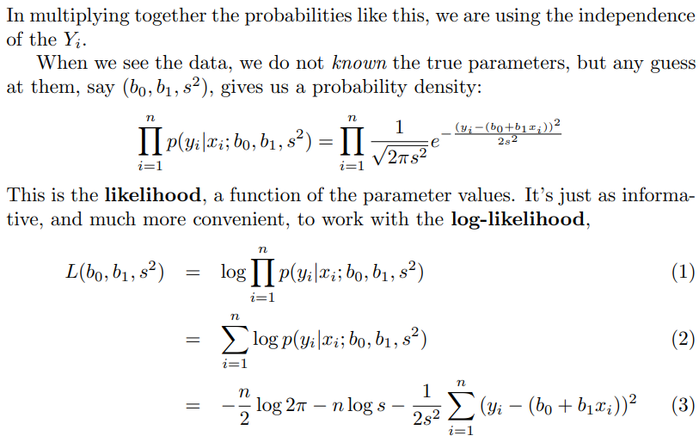
Linear regression is equivalent to doing MLE on the Gaussian target
https://www.stat.cmu.edu/~cshalizi/mreg/15/lectures/06/lecture-06.pdf

Slide 22
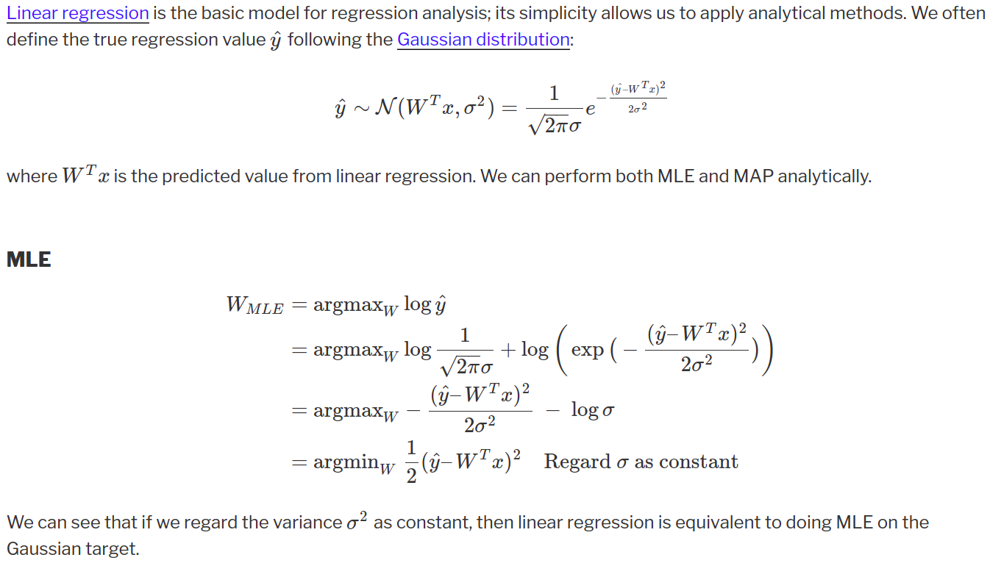
Linear regression is equivalent to doing MLE on the Gaussian target
https://liyanxu.blog/2021/03/11/mle_vs_map/

Slide 23
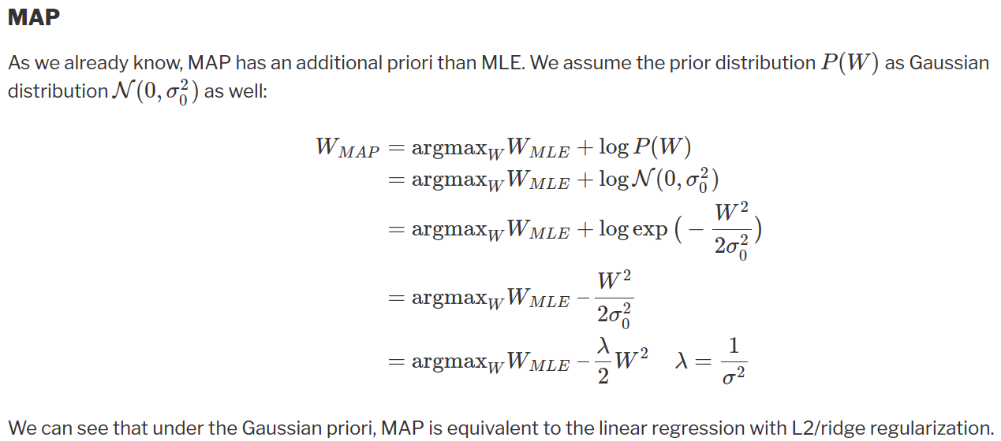
MAP is equivalent to the linear regression with L2/ridge regularization
https://liyanxu.blog/2021/03/11/mle_vs_map/

Slide 24
Multiple Linear Regression: Fitting a line going through multiple points with two features
Plant | x1 (Age, month) | x2 (Height, cm) | y (Weight, gram)
A | 1 | 10 | 1
B | 3 | 14 | 2
C | 4 | 18 | 2.5
... | ... | ... | ...
Matrix format: y = m1*x1 + m2*x2 + c

Slide 25
Multiple Linear Regression: Fitting a line going through multiple points with two features
Plant | x1 (Age, month) | x2 (Height, cm) | y (Weight, gram)
A | 1 | 10 | 1
B | 3 | 14 | 2
C | 4 | 18 | 2.5
... | ... | ... | ...
Matrix format: y = m1*x1 + m2*x2 + c
1 | 10 | 1
3 | 14 | 1
4 | 18 | 1
... |  | ...
1
2
2.5
...
m1
m2
c
=
$$Ax=b$$

Slide 26
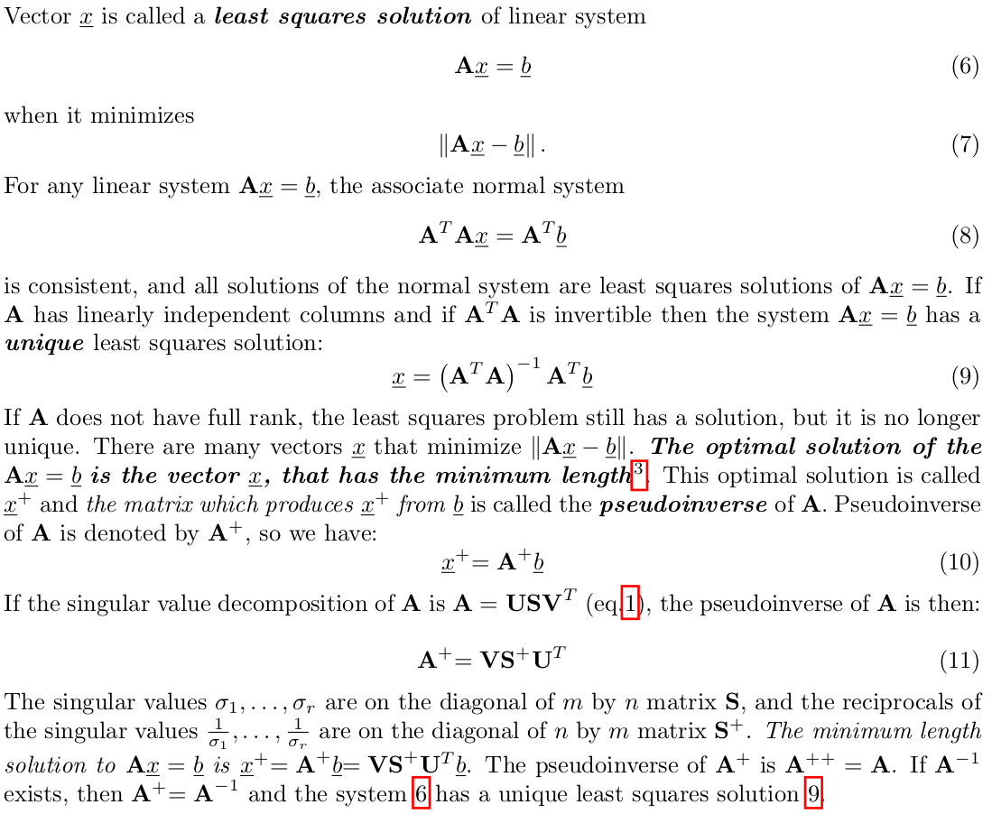
Least Squares and the Pseudoinverse

Slide 27
Least Squares and gradient descent
e_{A} = y_{Aline} - y_{A}
e_{B} = y_{Bline} - y_{B}
e_{C} = y_{Cline} - y_{C}
e = ?
e_{C}
e_{B}
e_{A}

Slide 28
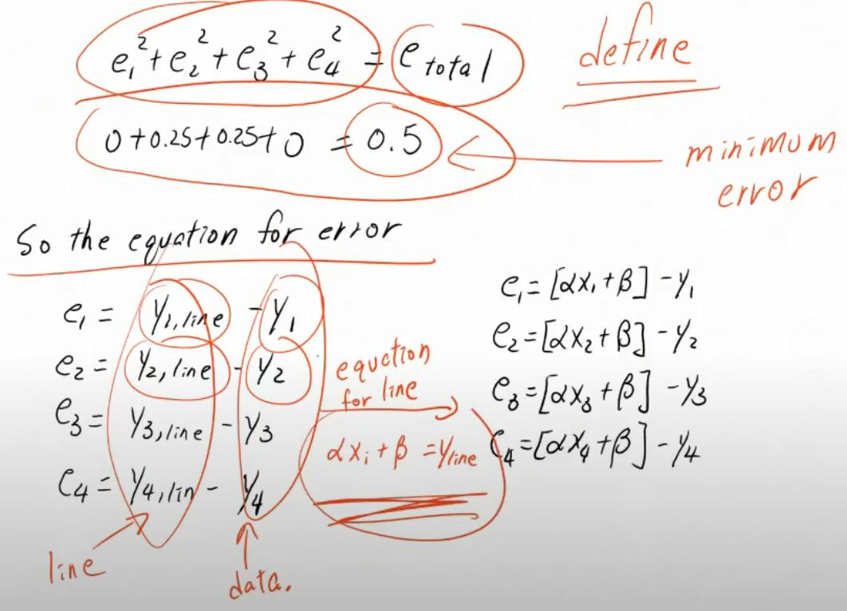
Least Squares and gradient descent
e_{A} = y_{Aline} - y_{A}
e_{B} = y_{Bline} - y_{B}
e_{C} = y_{Cline} - y_{C}
e = ?
e_{C}
e_{B}
e_{A}

Slide 29
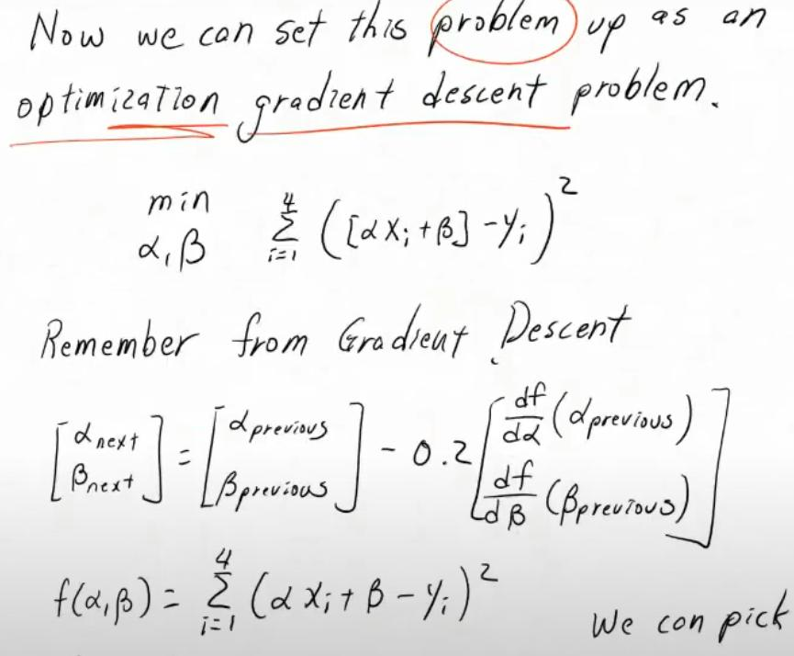
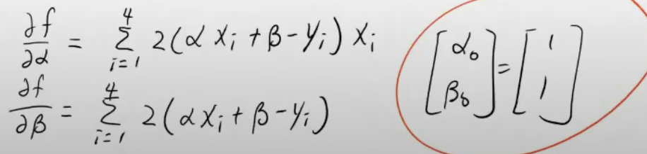
Least Squares and gradient descent
e_{C}
e_{B}
e_{A}

